Slide 1
ERA-Net Smart Energy Systems
Flexi-Sync
Flexible energy system integration using concept development, demonstration and replication
Demo site Maria Laach, Austria
Josef Petschko

Slide 2
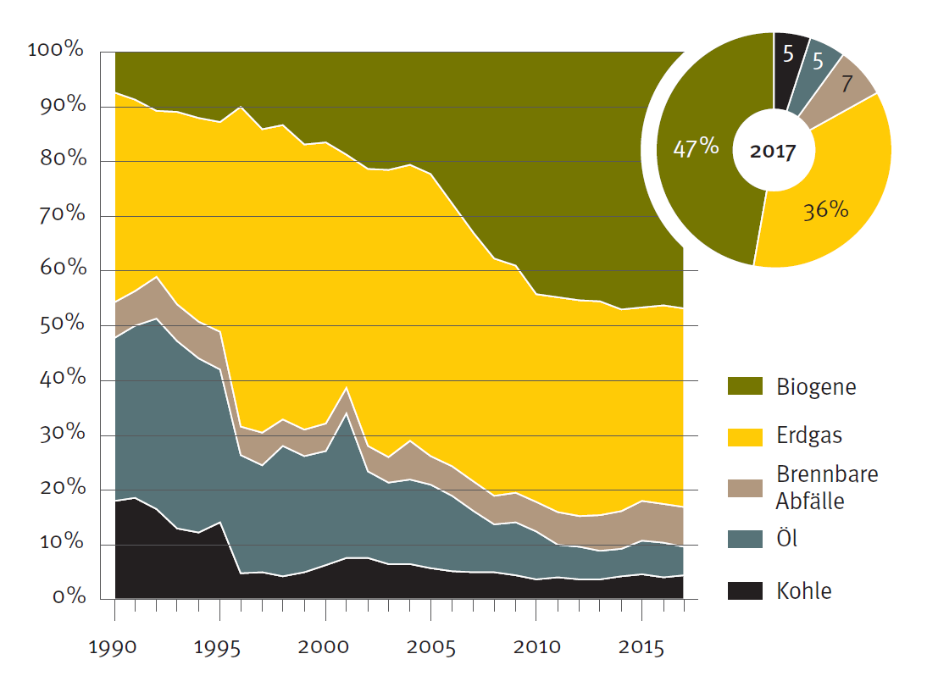
Country context District Energy in Austria
Started in around 1950 in the cities Baden, Klagenfurt, Wels, St. Pölten
Followed in the middle of the 1960s in Vienna (now 400000 appartments + 6800 mayor customer are supplied)
2019: 25% of appartments in Austria are supplied by district heating
Final energy consumption (FEC) (agriculture, households, service industry, traffic, producing sector): 1140 PJ (2017)
Space heating: 297 PJ 26% of FEC
District heating: 86 PJ 29 % of heating
Energy mix of district heat
biomass
Natural gas
Waste
Fuel oil
coal
Source: Statisik Austria

Slide 3
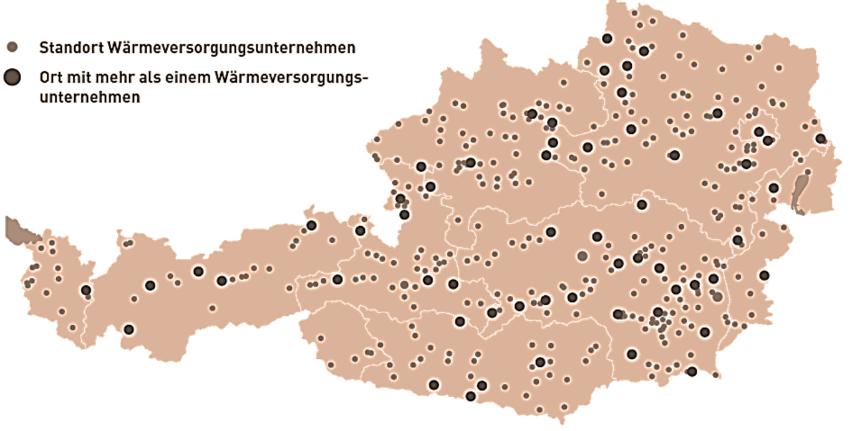
Country context DHC Network in Austria
Location DH companies
Location of multiple DH companies
District cooling
In Austria, more that 2.000 heat networks are existing (among them a large number of smal biomass networks, district cooling has only a minor role limited to some cities.

Slide 4
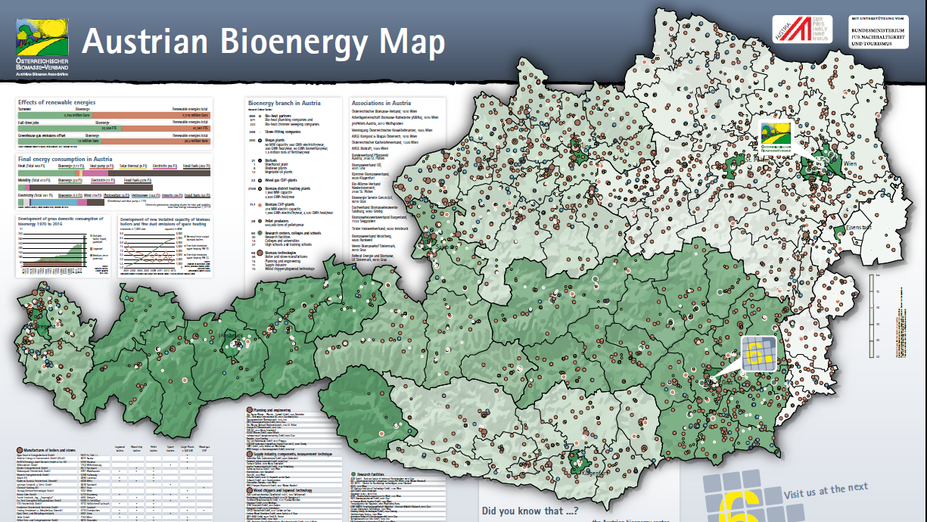
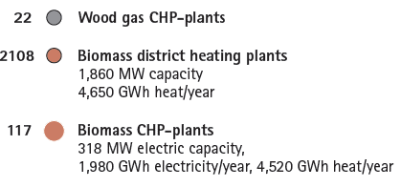
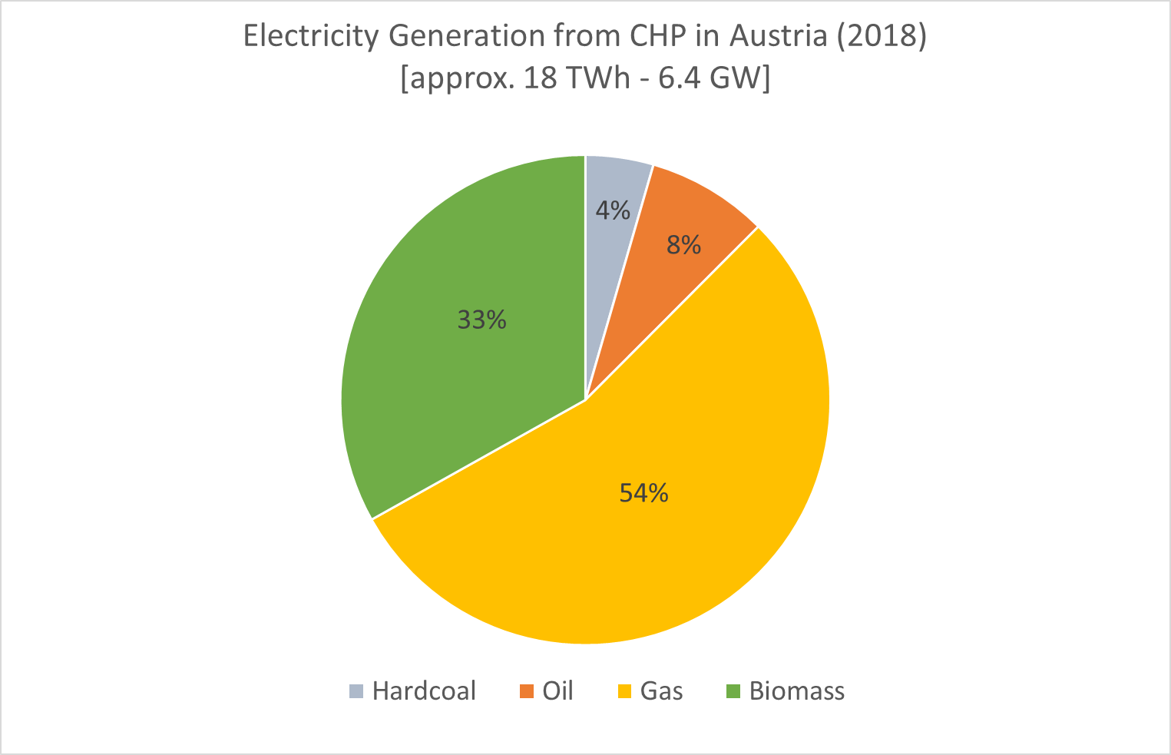
*The map shows also plumbing and chimney sweeping companies, biofuel plants,
Pellet producers, Research centers, technology manufactures, engineering companies …
http://www.biomasseverband.at/publikationen/poster/

Slide 5
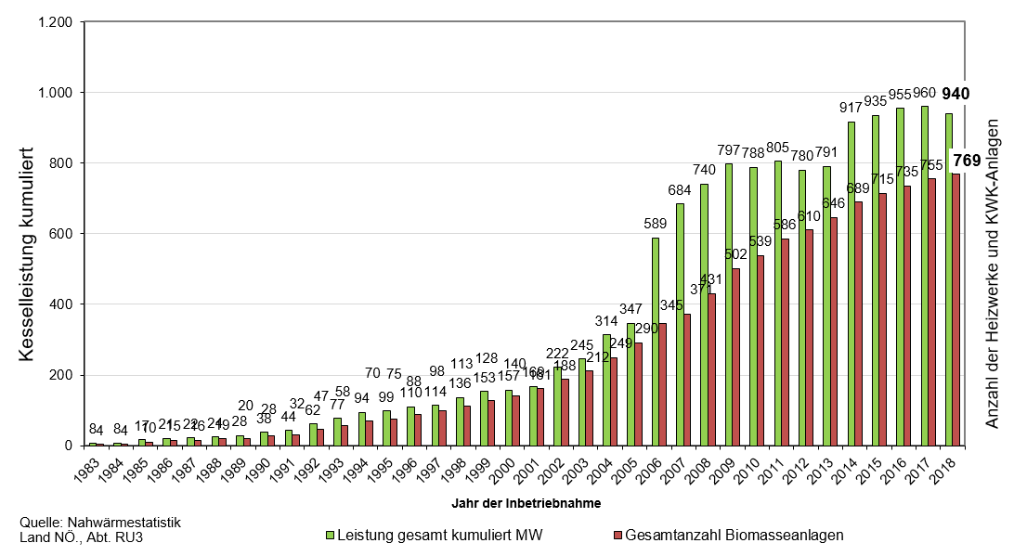
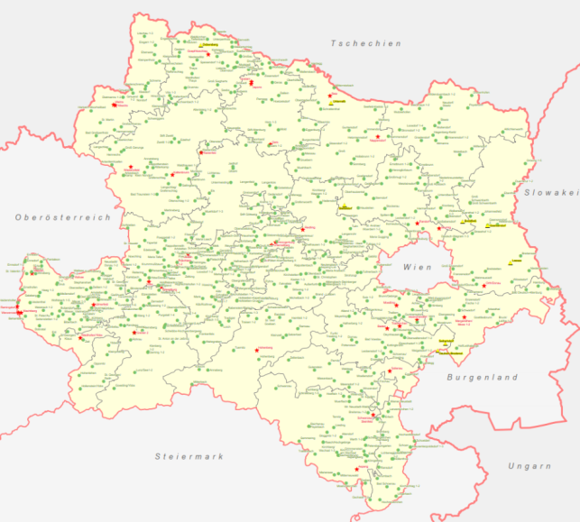
Development of biomass district heating
in Lower Austria
Number of district heating plants and chp plant
Year of installation
Total output cumulated
Total number of biomass plants

Slide 6
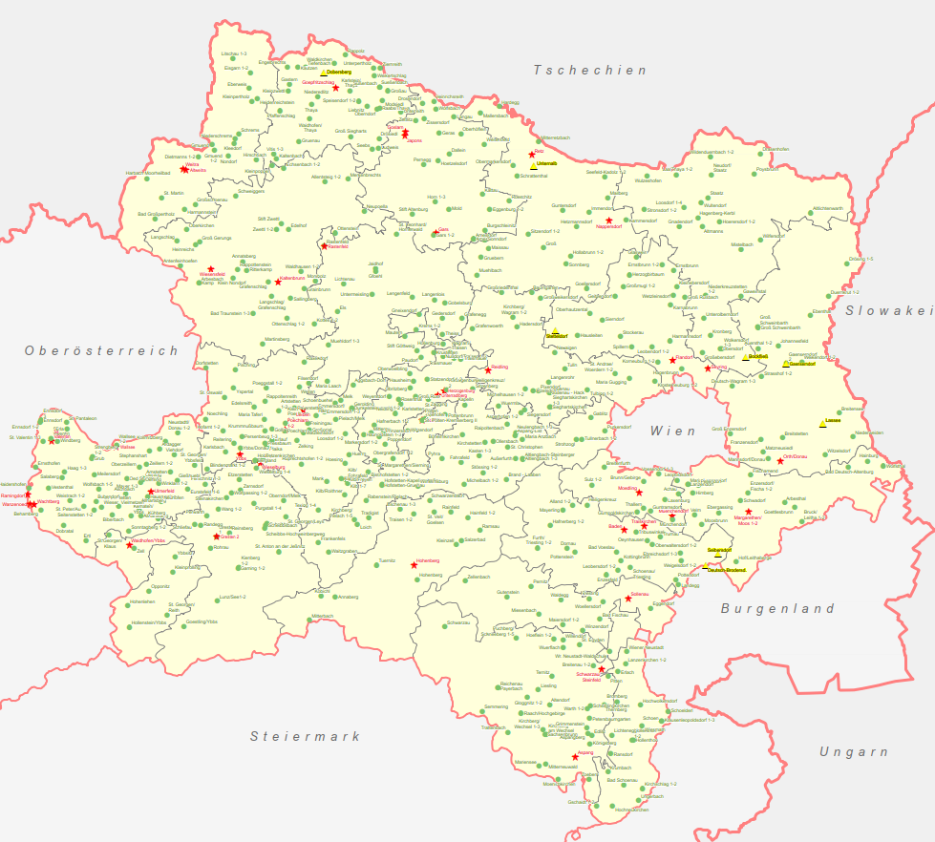
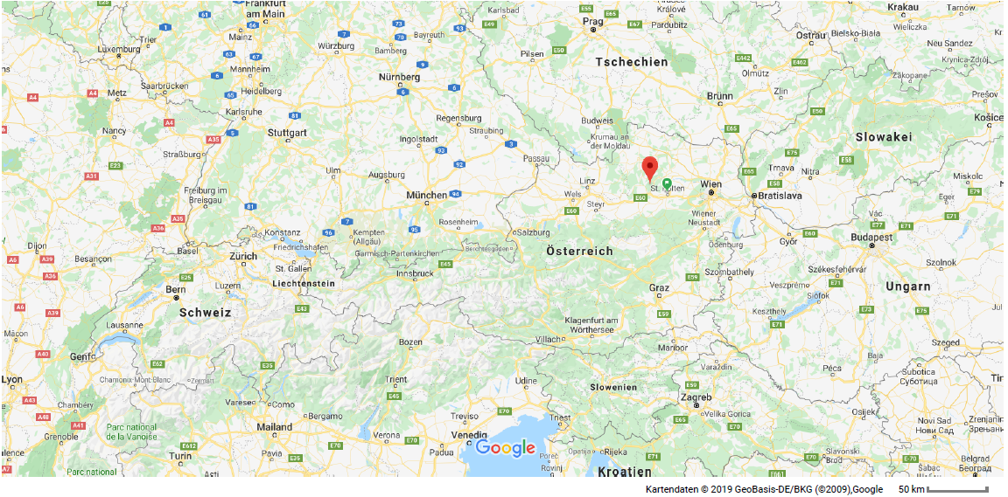
Demo site description Maria Laach
Flexi-Sync

Slide 7
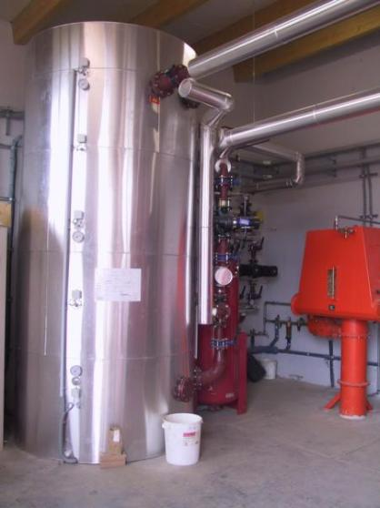
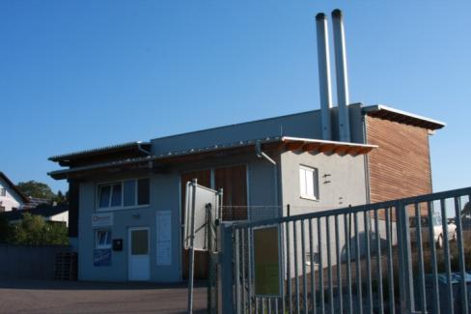
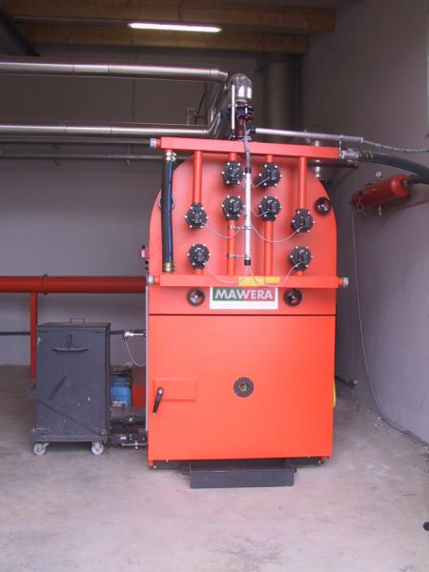
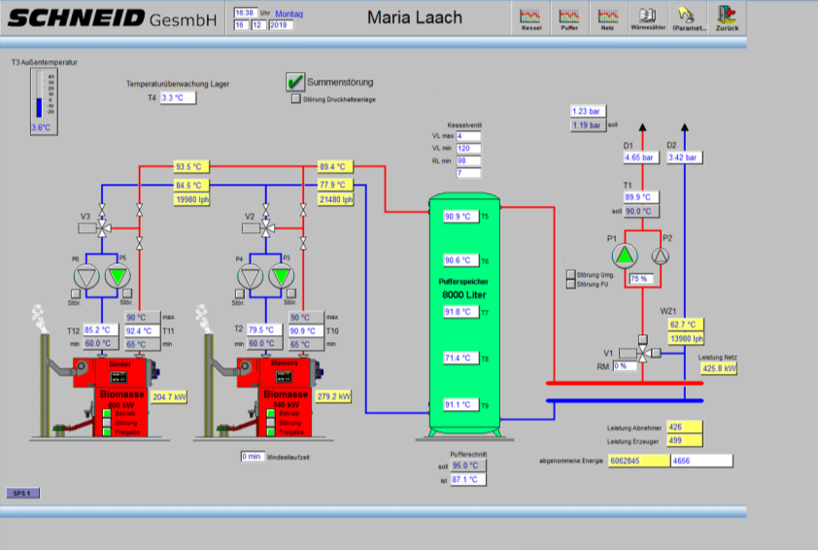
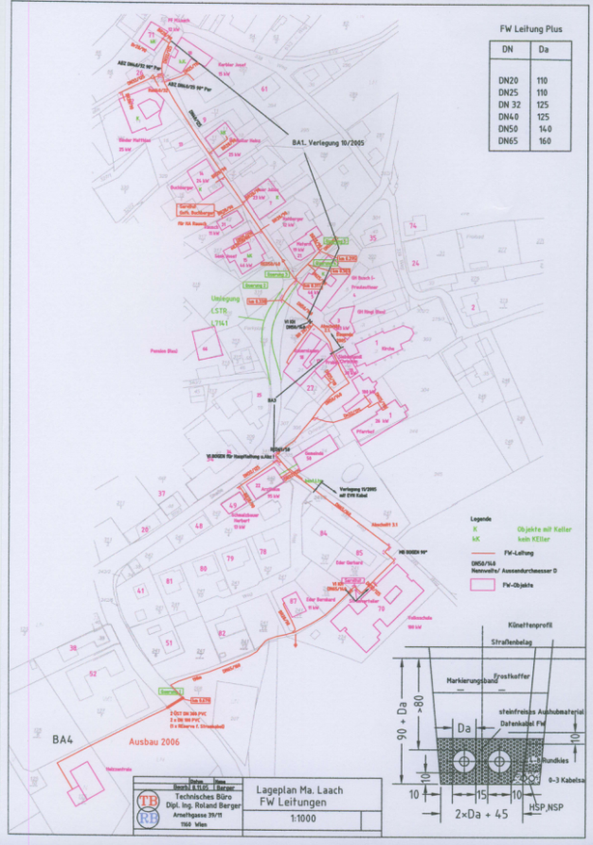
Demo site description Maria Laach
Flexi-Sync
Description of the supply side of the demo site:
2 biomass boilers total output 1200 kW
8 m³ buffer storage tank for load compensation
2 grid pumps winter/summer
1.5 km grid length
Visualisation of boilers, plant and substation
Operation focus: high utilisation grade of biomass
Future development: integration of 50 kW el wood pyrolysis CHP

Slide 8
Demo site description Maria Laach
Flexi-Sync
Description of the demand side of the demo site:
30 heat consumers
Main consumers: restaurants, hotels, school, public buidlings multifamily appartment buildings each 120 – 215 MWh/a heat demand
Further consumers: single family buildings, small public buidlings
Several substations at consumers are installed with buffer storage tanks, planned to be used as a common storage tank for the whole plant
Total heat demand 1650 MWh/a

Slide 9
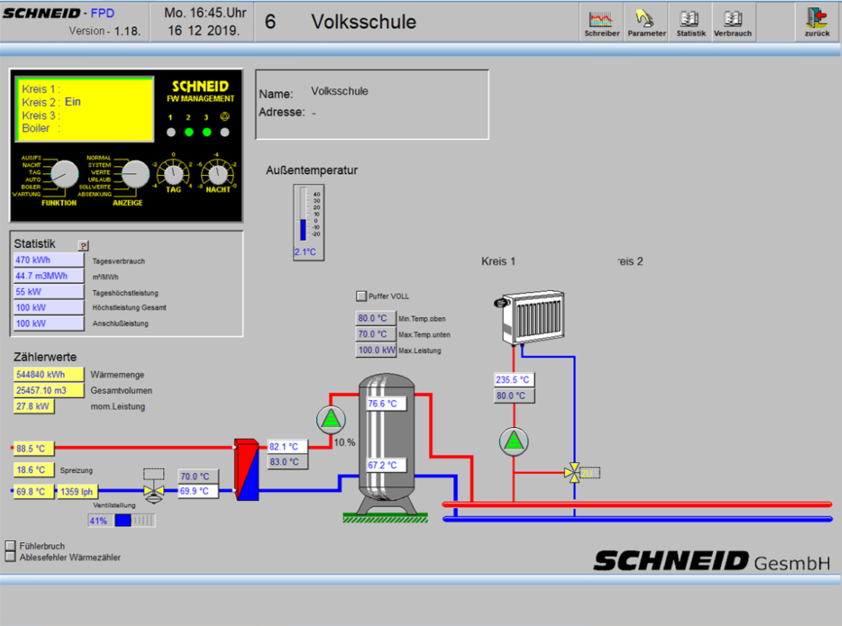
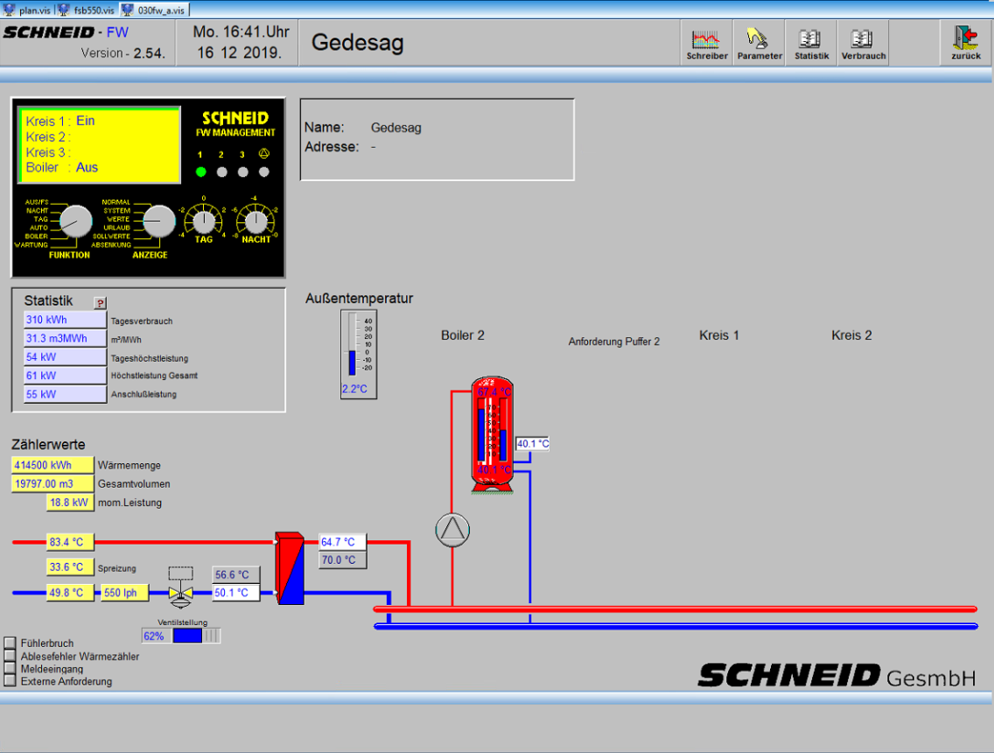
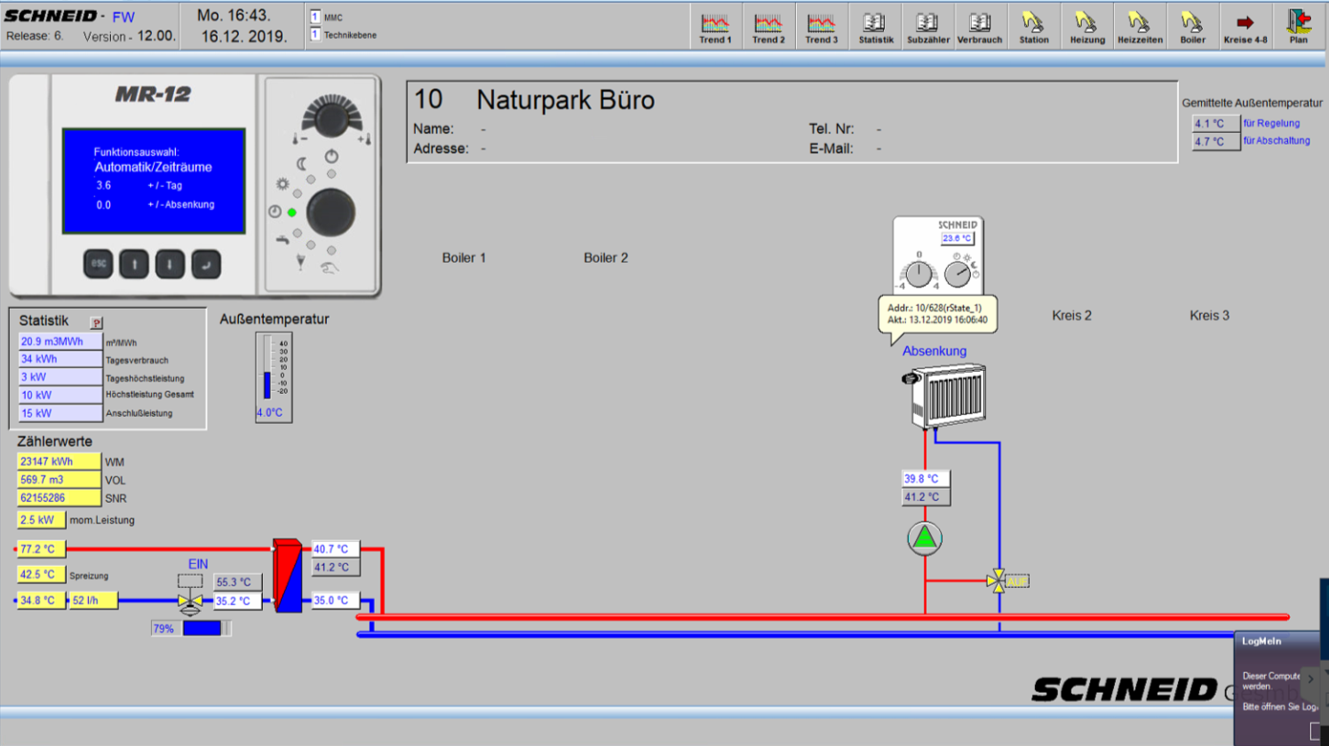
Demo site description Maria Laach
Flexi-Sync

Slide 10
Expected flexibility output
Reduction of peak loads at costumers and plant
Dynamic adaption of grid temperatures
→ reduction of heat losses
Reduction of return temperatures
Dynamic management of buffer storage tanks at costumers
Maximum exclusive operation of CHP plant
→ late start / early stop of biomass boilers
No disadvantages for heat costumers!!! → security backup?!
Conformity with data protection regulations!!!

Slide 11
Disclaimer
Flexi-Sync
The content and views expressed in this material are those of the authors and do not necessarily reflect the views or opinion of the ERA-Net SES initiative. Any reference given does not necessarily imply the endorsement by ERA-Net SES.
About ERA-Net Smart Energy Systems | www.eranet-smartenergysystems.eu
ERA-Net Smart Energy Systems (ERA-Net SES) is a transnational joint programming platform of 30 national and regional funding partners for initiating co-creation and promoting energy system innovation. The network of owners and managers of national and regional public funding programs along the innovation chain provides a sustainable and service oriented joint programming platform to finance projects in thematic areas like Smart Power Grids, Regional and Local Energy Systems, Heating and Cooling Networks, Digital Energy and Smart Services, etc.
Co-creating with partners that help to understand the needs of relevant stakeholders, we team up with intermediaries to provide an innovation eco-system supporting consortia for research, innovation, technical development, piloting and demonstration activities. These co-operations pave the way towards implementation in real-life environments and market introduction.
Beyond that, ERA-Net SES provides a Knowledge Community, involving key demo projects and experts from all over Europe, to facilitate learning between projects and programs from the local level up to the European level.

